Slide 1
Chapter 12 - Fine-Tuning Generation Models
From the book Hands-On Large Language Models

Slide 2
The Three LLM Training Steps: Pretraining, Supervised Fine-Tuning, and Preference Tuning
Language Modeling (Pretraining)
Fine-tuning 1 (Supervised Fine-Tuning)
Fine-tuning 2 (Preference Tuning)

Slide 3
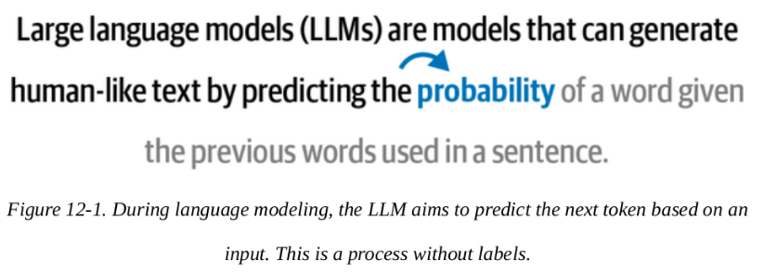
The Three LLM Training Steps: Pretraining, Supervised Fine-Tuning, and Preference Tuning
Language Modeling (Pretraining)
The first step in creating a high-quality LLM is to pretrain it on one or more massive text datasets. As we saw before in Chapters 3 and 11, this is called language modeling and is a self-supervised method. This produces a base model.

Slide 4
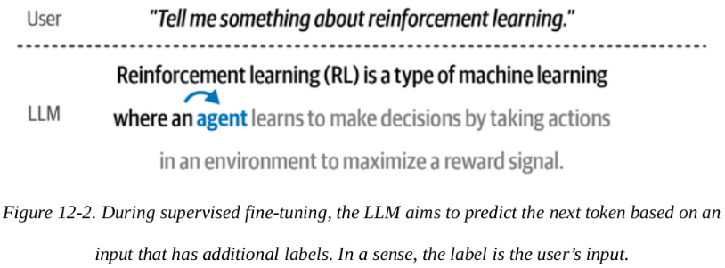
The Three LLM Training Steps: Pretraining, Supervised Fine-Tuning, and Preference Tuning
Fine-tuning 1 (Supervised Fine-Tuning)
With supervised fine-tuning (SFT), we can adapt the base model to follow instructions. Like a pretrained model, it is trained using next-token prediction but instead of only predicting the next token, it does so based on a user input.

Slide 5
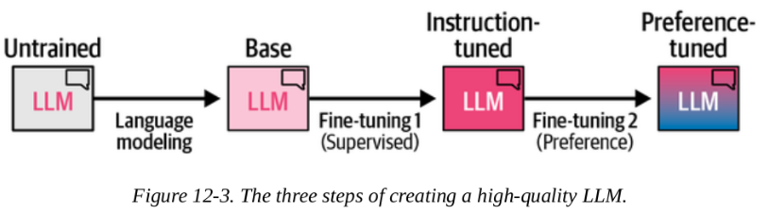
The Three LLM Training Steps: Pretraining, Supervised Fine-Tuning, and Preference Tuning
Fine-tuning 2 (Preference Tuning)
The final step further improves the quality of the model and makes it more aligned with the expected behavior of AI safety or human preferences.

Slide 6
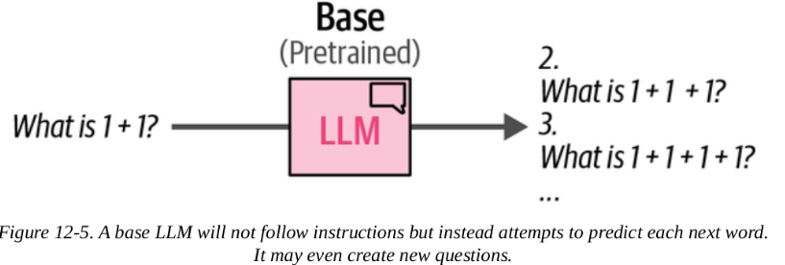
Supervised Fine-Tuning (SFT)
The purpose of pretraining a model on large datasets is that it is able to reproduce language and its meaning.
The model learns to complete input phrases as shown below.
The model was not trained to follow instructions and instead will attempt to complete a question rather than answer it.

Slide 7
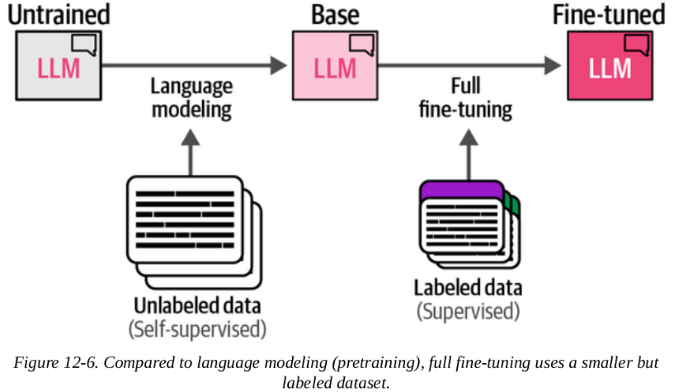
Full Fine-Tuning
To make the model answer questions instead of completing it, it needs supervised fine-tuning
The most common fine-tuning process is full fine-tuning.
Like pretraining an LLM, this involves updating all parameters of a model to be in line with your target task.

Slide 8
Full Fine-Tuning
To make the model answer questions instead of completing it, it needs supervised fine-tuning
The most common fine-tuning process is full fine-tuning.
Like pretraining an LLM, this involves updating all parameters of a model to be in line with your target task.

Slide 9
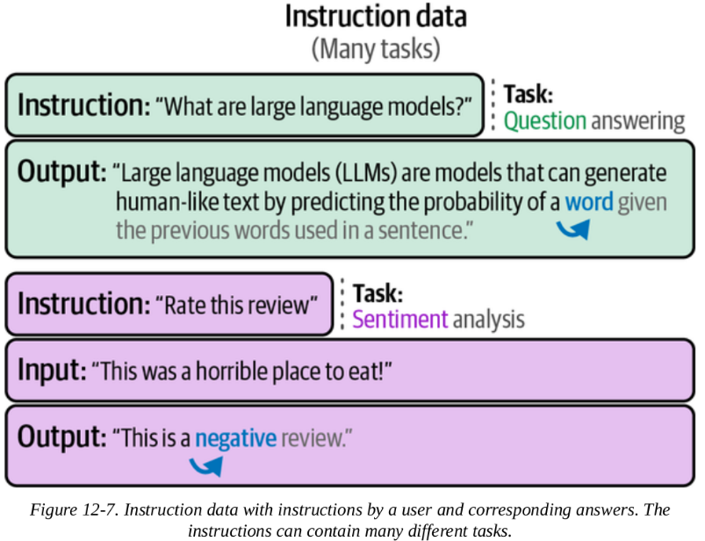
Full Fine-Tuning
To make our LLM follow instructions, we will need question-response data.
During full fine-tuning, the model takes the input (instructions) and applies next-token prediction on the output (response).
Instead of generating new questions, it will follow instructions.

Slide 10
Parameter-Efficient Fine-Tuning (PEFT)
Updating all parameters of a model has a large potential of increasing its performance but comes with several disadvantages:
It is costly to train
Has slow training times
Requires significant storage
To resolve address these, attention has been given to parameter-efficient fine-tuning (PEFT) alternatives that focus on fine-tuning pretrained models at higher computational efficiency.

Slide 11
Adapters
The method proposes a set of additional modular components inside the Transformer that can be fine-tuned to improve the model's performance on a specific task without having to fine-tune all the model weights.
It is costly to train
Has slow training times
Requires significant storage
To resolve address these, attention has been given to parameter-efficient fine-tuning (PEFT) alternatives that focus on fine-tuning pretrained models at higher computational efficiency.

Slide 12
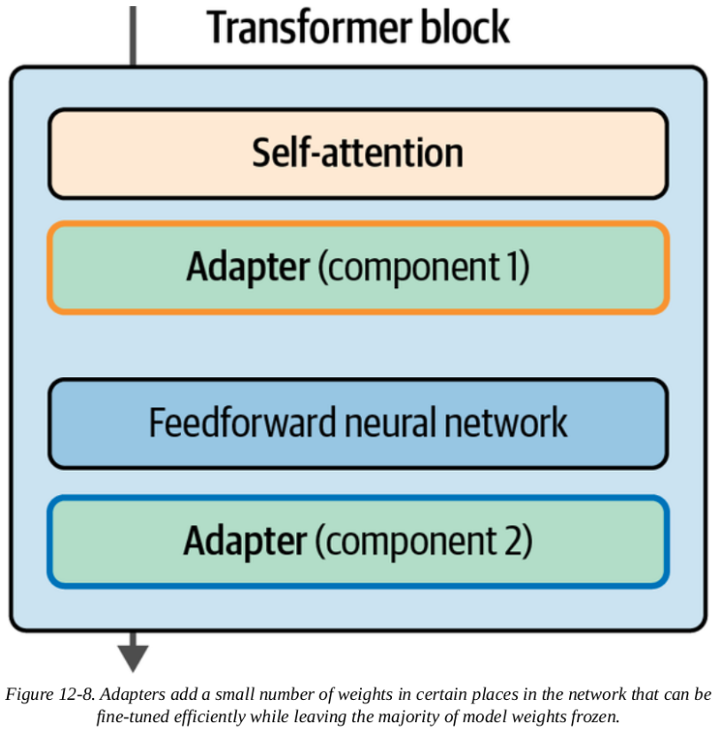
Adapters
Adapters are described in the paper "Parameter-efficient transfer learning for NLP"
It showed that fine-tuning 3.6% of the parameters of BERT for a task can yield comparable performance to fine-tuning all the model's weights.
The paper's proposed architecture places adapters after the attention layer and the feedforward neural network

Slide 13
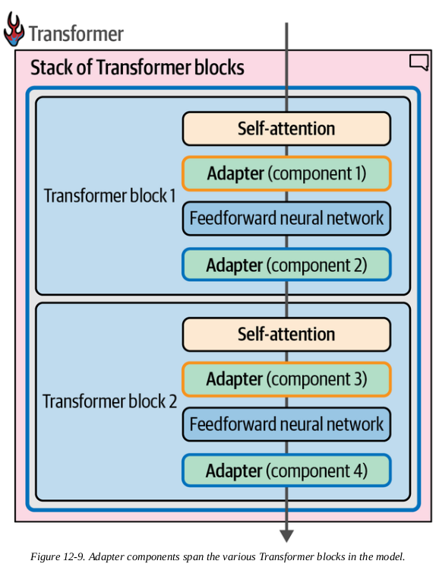
Adapters
It's not enough to only change one Transformer block, so these components are part of every block in the model.
Seeing all the adapter's components across the model like this enables us to see individual adapters
Adapter 1 can be a specialist in, say, medical text classification, while Adapter 2 can specialize in named-entity recognition (NER)

Slide 14
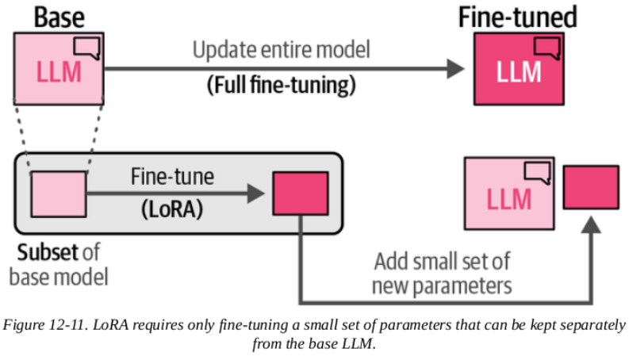
Low-Rank Adaptation (LoRA)
As an alternative to adapters, low-rank adaptation (LoRA) was introduced and is at the time of writing a widely used and effective technique for PEFT
LoRA is a technique that (like adapters) only requires updating a small set of parameters.

Slide 15
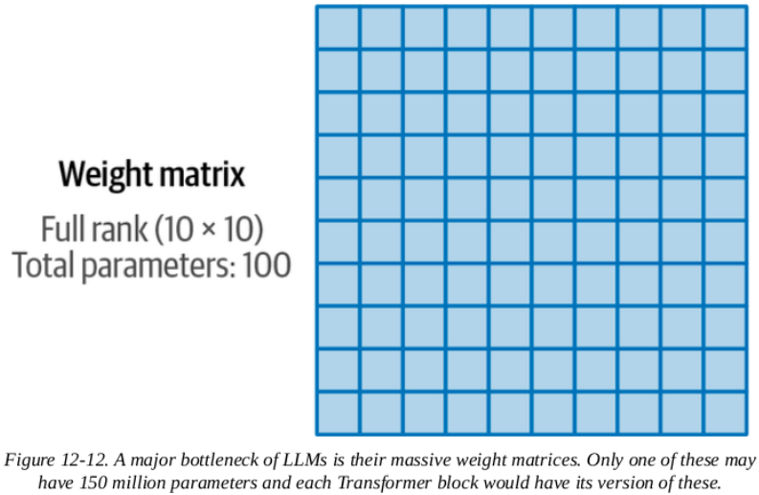
Low-Rank Adaptation (LoRA)
We approximate the LLM's large matrices with smaller ones.
Fine-tuning only these smaller matrices is much faster than training the original model.

Slide 16
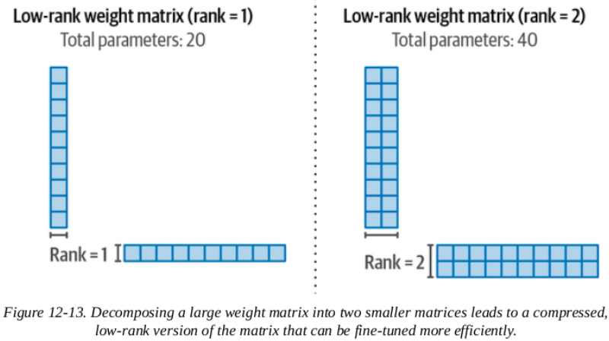
Low-Rank Adaptation (LoRA)
We can use two smaller matrices, which when multiplied, build a 10 × 10 matrix.
We now only have 20 weights (10 plus 10), instead of 100 (10 x ten)

Slide 17
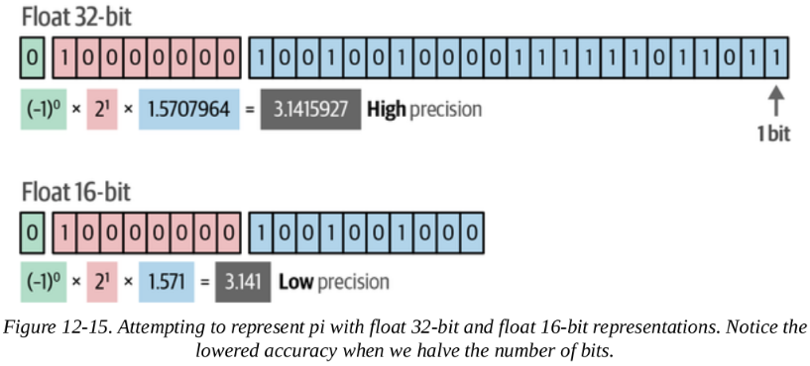
Compressing the Model for (More) Efficient Training
We can make LoRA even more efficient by reducing the memory requirements of the model's original weights
If we lower the amount of bits to represent a value, we get a less accurate result, but we also lower the memory requirements of that model.

Slide 18
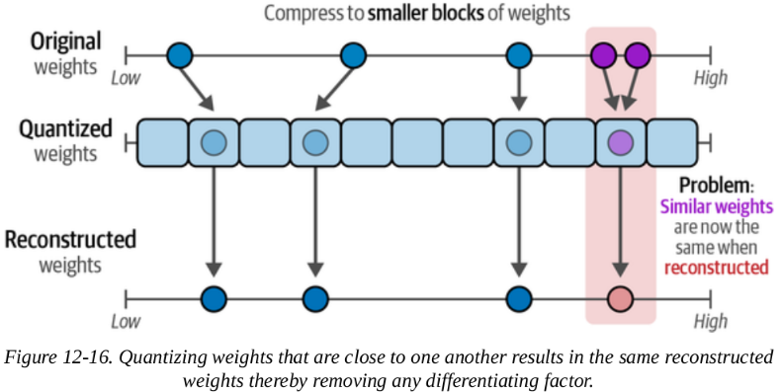
Compressing the Model for (More) Efficient Training
With quantization, we aim to lower the number of bits while still accurately representing the original weight values
the authors of QLoRA, found a way to go from a higher number of bits to a lower value and vice versa without differentiating too much from the original weights.

Slide 19
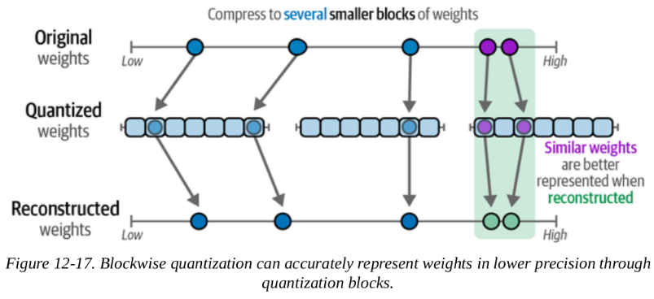
Compressing the Model for (More) Efficient Training
They used blockwise quantization to map certain blocks of higher precision values to lower precision values.
Instead of directly mapping higher precision to lower precision values, additional blocks are created that allow for quantizing similar weights.

Slide 20
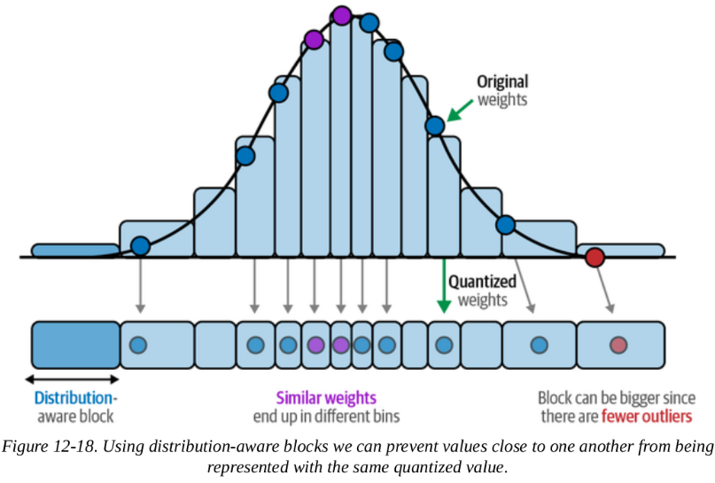
Compressing the Model for (More) Efficient Training
A property of neural networks is that their values are generally normally distributed between –1 and 1
This allows us to bin the original weights to lower bits based on their relative density.

Slide 21
Compressing the Model for (More) Efficient Training
Normalization, combined with blockwise quantization, allows for accurate representation of high precision values by low precision values with only a small decrease in the LLM’s performance.
As a result we can go from a 16-bit float representation to a 4-bit normalized float representation.

Slide 22
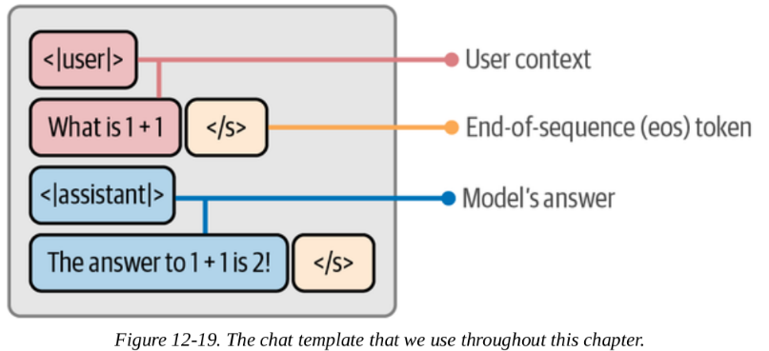
Templating Instruction Data
Now, we will fine-tune a completely open source and smaller version of Llama, TinyLlama, to follow instructions using the QLoRA procedure.
To have the LLM follow instructions, we will need to prepare instruction data that follows a chat template

Slide 23
Templating Instruction Data
We chose this chat template since the chat version of TinyLlama uses the same format.
The template uses:
<|user|> - User context
- </s> - End-of-sequence token
<|assistant|> - Model's answer
The data that we are using is a small subset of the UltraChat dataset.
A dataset that contains almost 200k conversations between a user and an LLM

Slide 24
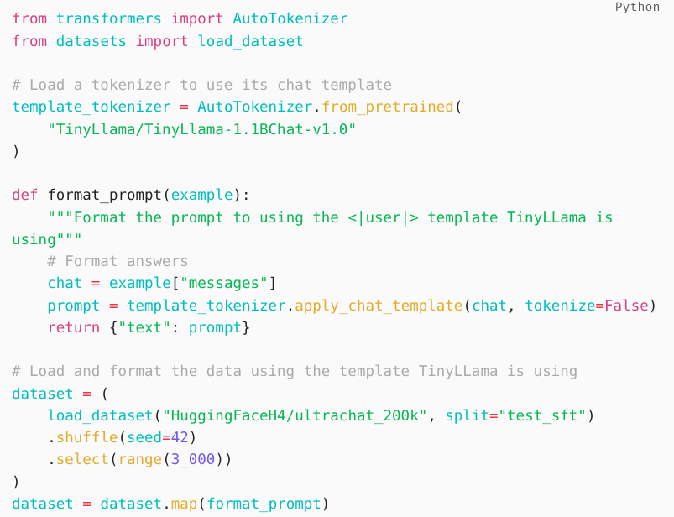
Templating Instruction Data
We create a function, format_prompt, to make sure that the conversations follow this template:

Slide 25
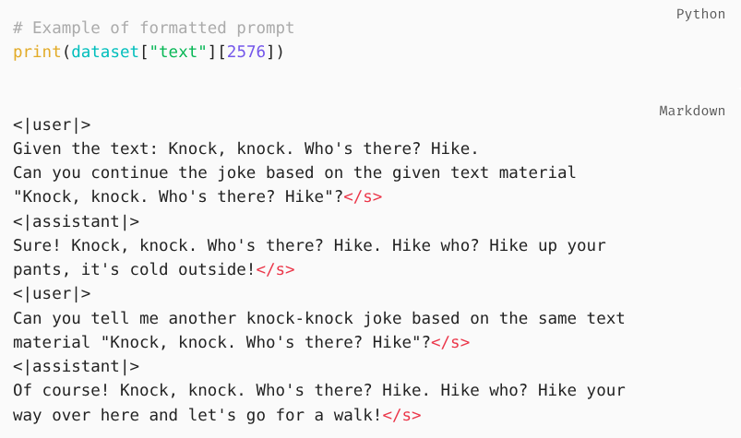
Templating Instruction Data
Using the "text" column, we can explore these formatted prompts:

Slide 26
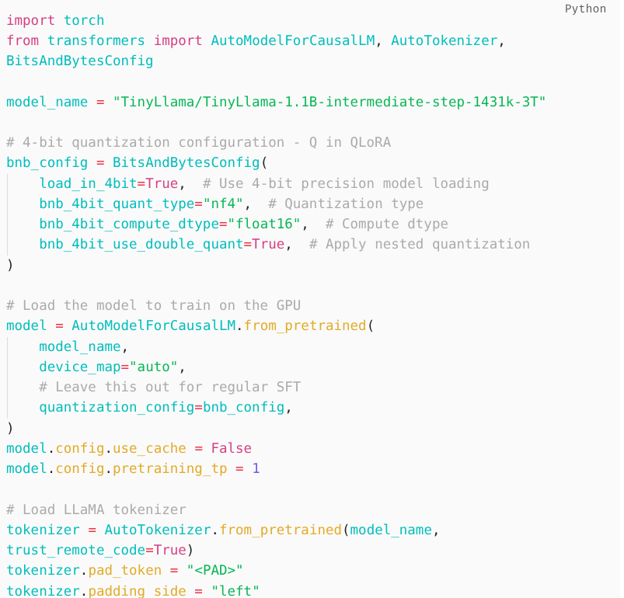
Model Quantization
Now that we have our data, we can start loading in our model
This is where we apply the Q in QLoRA - quantization.
We use the bitsandbytes package to compress the pretrained model to a 4-bit representation.

Slide 27
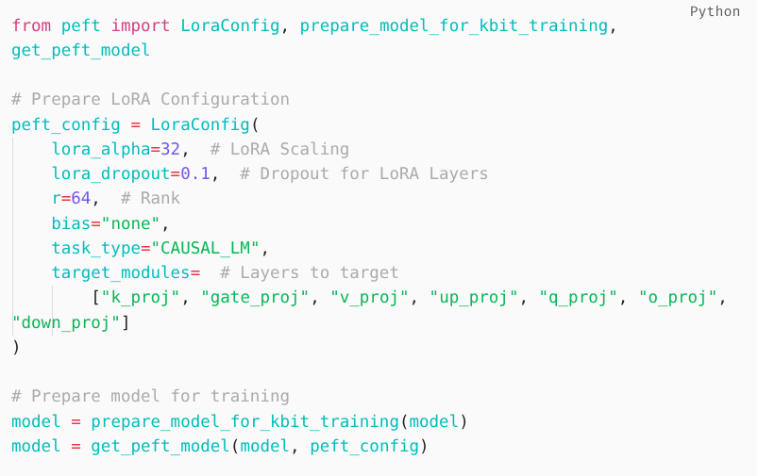
LoRA Configuration
Next, we will need to define our LoRA configuration using the peft library

Slide 28
LoRA Configuration
There are several parameters worth mentioning:
r
This is the rank of the compressed matrices. Increasing this value will also increase the sizes of the compressed matrices leading to less compression -> better representative power.
lora_alpha
Controls the amount of change that is added to the original weights.
target_modules
Controls which layers to target. The LoRA procedure can choose to ignore specific layers, like specific projection layers.

Slide 29
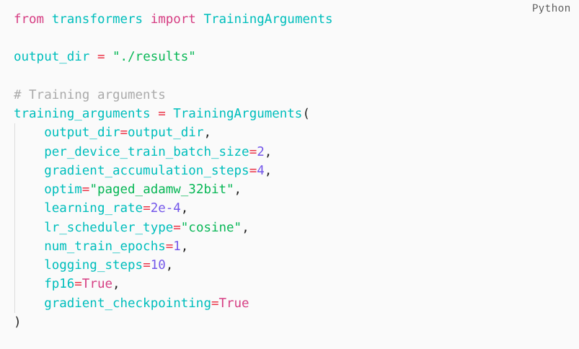
Training Configuration
We need to configure our training parameters as we did in Chapter 11:

Slide 30
LoRA Configuration
num_train_epochs
The total number of training rounds.
learning_rate
Determines the step size at each iteration of weight updates. The authors of QLoRA found that higher learning rates work better for larger models (>33B parameters).
lr_scheduler_type
It will linearly increase the learning rate, starting from zero, until it reaches the set value.
optim
The paged optimizers used in the original QLoRA paper.

Slide 31
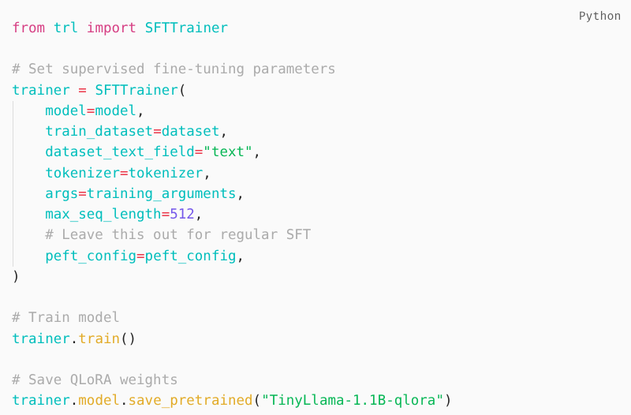
Training
Now that we have prepared all our models and parameters, we can start fine-tuning the model:

Slide 32
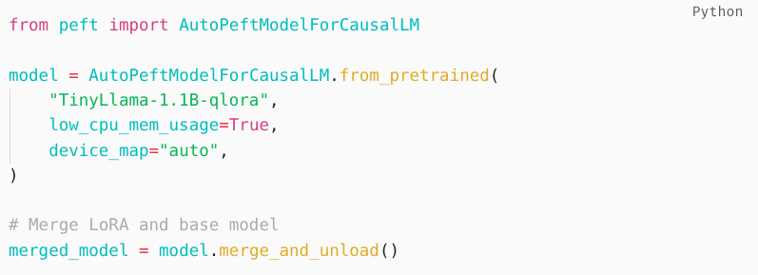
Merge Weights
After we have trained our QLoRA weights, we still need to combine them with the original weights to use them.
We reload the model in 16 bits, instead of the quantized 4 bits, to merge the weights.

Slide 33
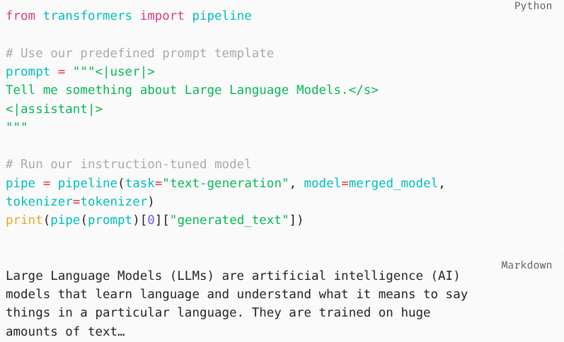
Merge Weights
After merging, we can use it with the prompt template:
The output shows that the model now follows our instructions, which is not possible with the base model.

Slide 34
Leaderboards
Leaderboards were developed containing multiple benchmarks.
A common leaderboard is the Open LLM Leaderboard which includes the following benchmarks:
HellaSwag
MMLU
TruthfulQA
GSM8k
Models that top the leaderboard, assuming they were not overfitted on the data, are generally regarded as the "best" model.

Slide 35
Automated Evaluation
The Challenge:
Text quality matters beyond correctness (reasoning path, conciseness, construction)
Same answer can be derived differently; summaries can vary in length/quality
Solution: LLM-as-a-Judge
Separate LLM evaluates the quality of the target LLM's output
Pairwise comparison variant: Two LLMs generate answers -> third LLM judges which is better
Advantages:
Automated evaluation of open-ended questions
Evaluation improves as LLMs improve (methodology grows with the field)

Slide 36
Human Evaluation
Why Human Evaluation Matters:
Gold standard beyond benchmarks
Benchmarks don't capture domain-specific performance or human preference
Current methods are not perfect measures
Chatbot Arena Example:
Users interact with two anonymous LLMs
Vote for preferred response -> models revealed after
800,000+ votes used to compute rankings
Elo rating system (from chess): win rates determine relative skill
Low-ranked beating high-ranked = significant ranking change
Limitation: Crowdsourced opinions may not match your specific use case

Slide 37
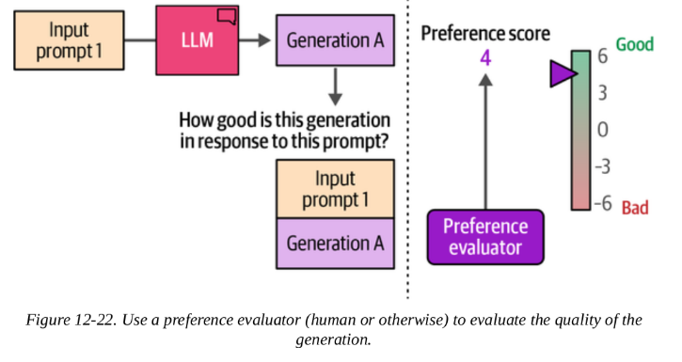
Preference-Tuning/Alignment/RLHF
Although our model can now follow instructions, we can improve it more by a final training phase to align it with our preferences.
We can ask a person (preference evaluator) to evaluate the quality of that model generation:

Slide 38
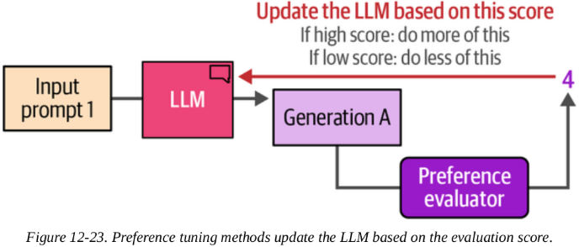
Preference-Tuning/Alignment/RLHF
A preference tuning step updates the model based on that score:
If the score is high, the model is updated to encourage it to generate more like this type of generation.
If the score is low, the model is updated to discourage such generations

Slide 39
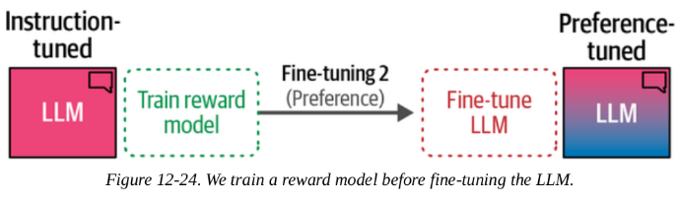
Automating Preference Evaluation Using Reward Models
To automate preference evaluation, we need a step before the preference-tuning step, namely to train a reward model:

Slide 40
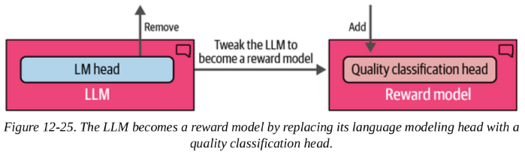
Automating Preference Evaluation Using Reward Models
To create a reward model, we take a copy of the instruction-tuned model and slightly change it so that instead of generating text, it now outputs a single score.

Slide 41
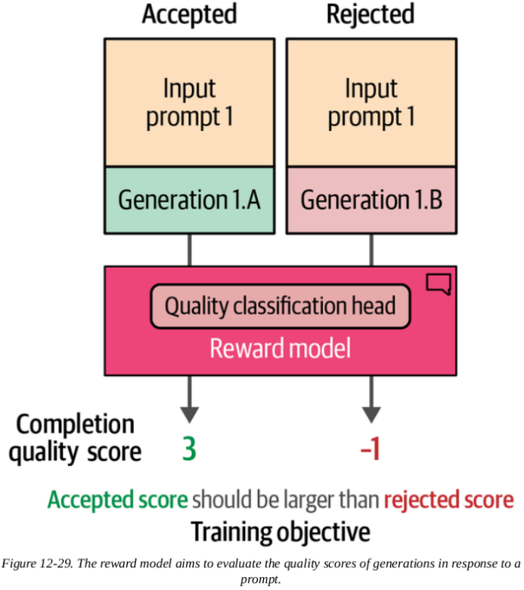
Reward model training step
Now that we have the preference training dataset, we can train the reward model.
A simple step is that we use the reward model to:
Score the accepted generation
Score the rejected generation

Slide 42
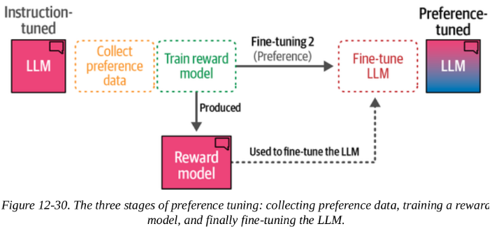
Reward model training step
When we combine everything together, we get the three stages to preference tuning:
Collect preference data
Train a reward model
Use the reward model to fine-tune the LLM (operating as the preference evaluator)

Slide 43
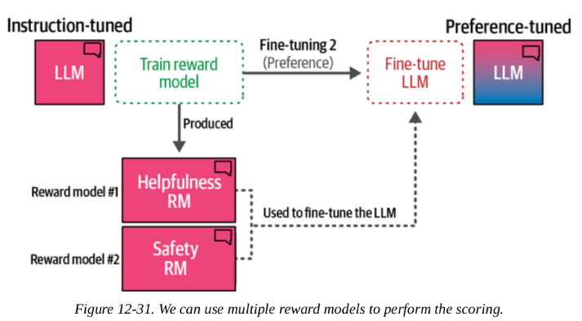
Reward model training step
Proximal Policy Optimization (PPO) is a popular reinforcement technique that optimizes the instruction-tuned LLM by making sure that the LLM does not deviate too much from the expected rewards.

Slide 44
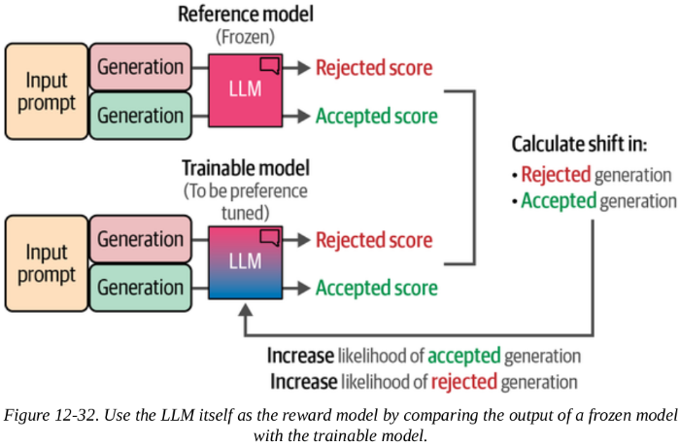
Training No Reward Model
A disadvantage of PPO is that it is a complex method that needs to train at least two models
Direct Preference Optimization (DPO) is an alternative to PPO and does away with the reinforcement-based learning procedure.
Instead of using the reward model to judge the quality of a generation, we let the LLM itself do that.

Slide 45
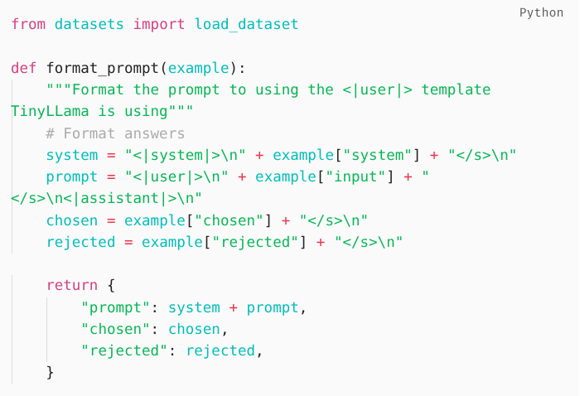
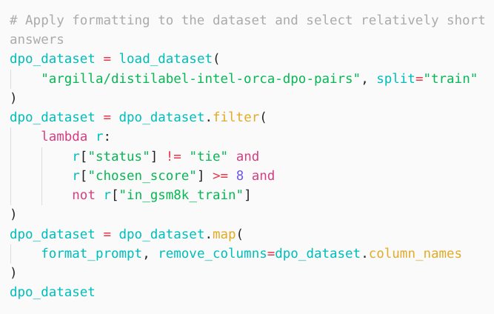
Preference Tuning with DPO
Templating Alignment Data
We will use a dataset that for each prompt contains an accepted generation and a rejected generation.

Slide 46
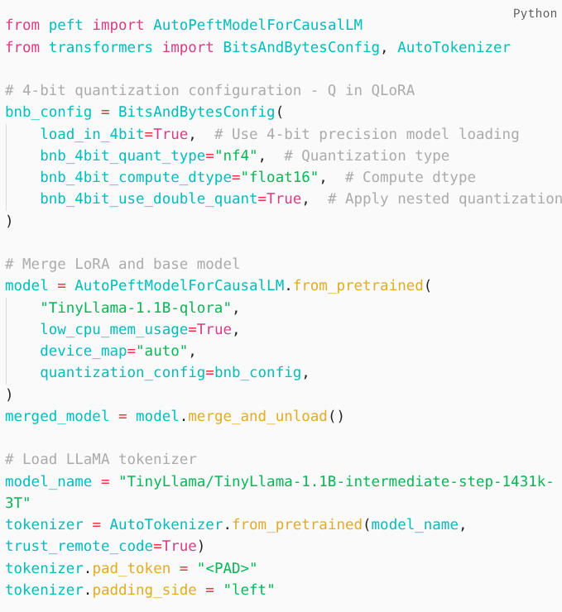
Preference Tuning with DPO
Model Quantization
As before, we quantize the model to reduce the necessary VRAM for training:

Slide 47
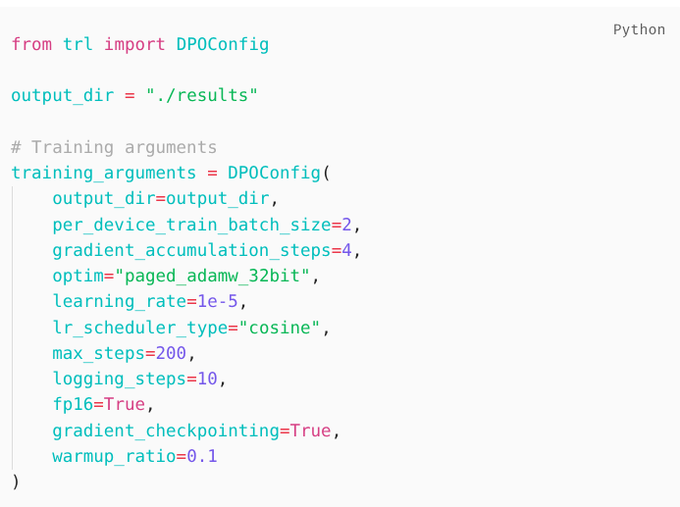
Preference Tuning with DPO
Training Configuration
For the sake of simplicity, we will use the same training arguments as we did before with one difference.
We added the warmup_ratio parameter, increasing the learning rate from 0 to the learning_rate value we set for the first 10% of steps.

Slide 48
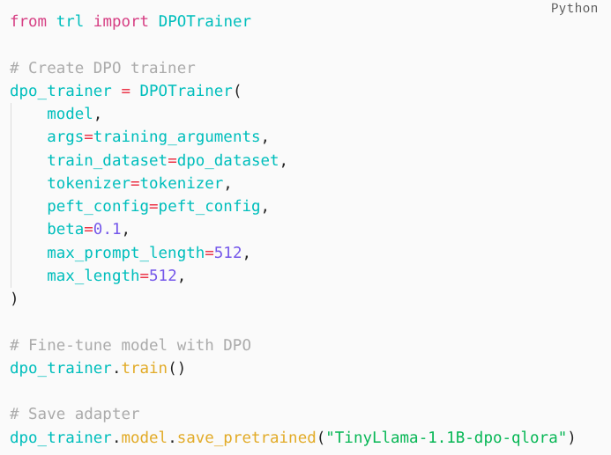
Preference Tuning with DPO
Training
Now that we have prepared all our models and parameters, we can start fine-tuning our model:

Slide 49
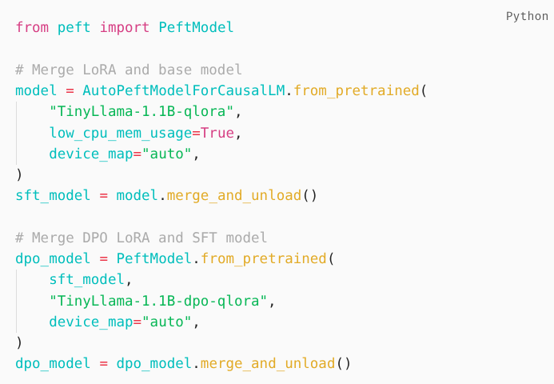
Preference Tuning with DPO
Training
We have created a second adapter. To merge both adapters, we iteratively merge the adapters with the base model:

Slide 50
Preference Tuning with DPO
The Two-Stage Approach (SFT + DPO)
This combination of SFT and DPO is a great way to first fine-tune your model to perform basic chatting and then align its answers with human preferences.
But it comes at a cost since we need to perform two training loops and potentially tweak the parameters in two separate processes.
A More Efficient Alternative: ORPO
Odds Ratio Preference Optimization (ORPO), a process that combines SFT and DPO into a single training process.
ORPO removes the need to perform two separate training loops

Slide 51
END

